Slide 1
Lab 1. Functions

Slide 2
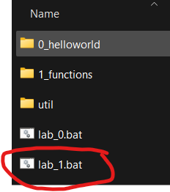
Homework 1
Download the lab file from GitHub.
Unzip the lab file.
Place the unzipped files to your labpack folder.
Double click the lab1.bat

Slide 3
Homework 1
Open heyjude.c
Trace the execution of the file, step by step, using the debugger.

Slide 4
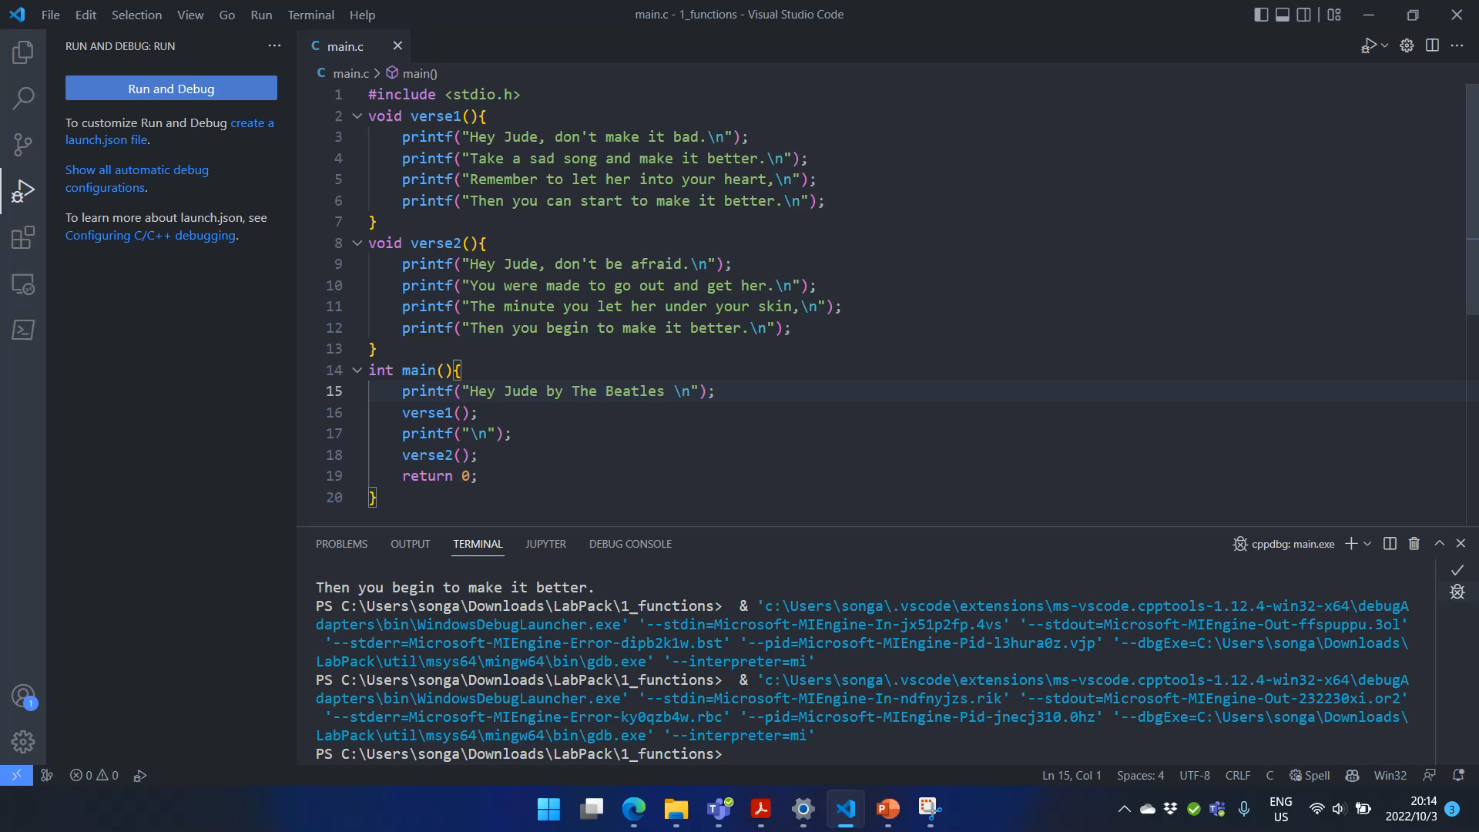
To enter a function, you need to click “Step Into” (F11), rather than click “Step Over” (F10).
If you “step over” a function, the debugger will not enter the function while it is being executed.

Slide 5
Homework 2
Open file: “goofookoo.c”
Do NOT run the code for now.
Read the code and write down the output of this program on a paper.
Now, run the code, check your answer. Did you get it right? Use the debugger to trace the program if you are confused.
This was a last year’s written exam question.

Slide 6
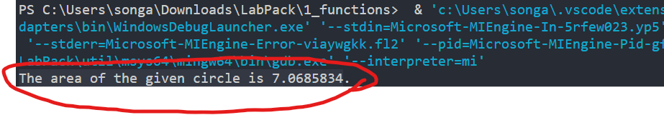
Homework 3
Study the “calculate_circumference” example in the lecture slides.
Write a function named “calculate_area” which returns the area of a circle given a radius.
Your function should have 1 input and 1 output.
Write a “main” function that calls “calculate_area” and print out the returned area.
The printout should read:
“The area of the give circle is X.XXXXXXX.”

Slide 7
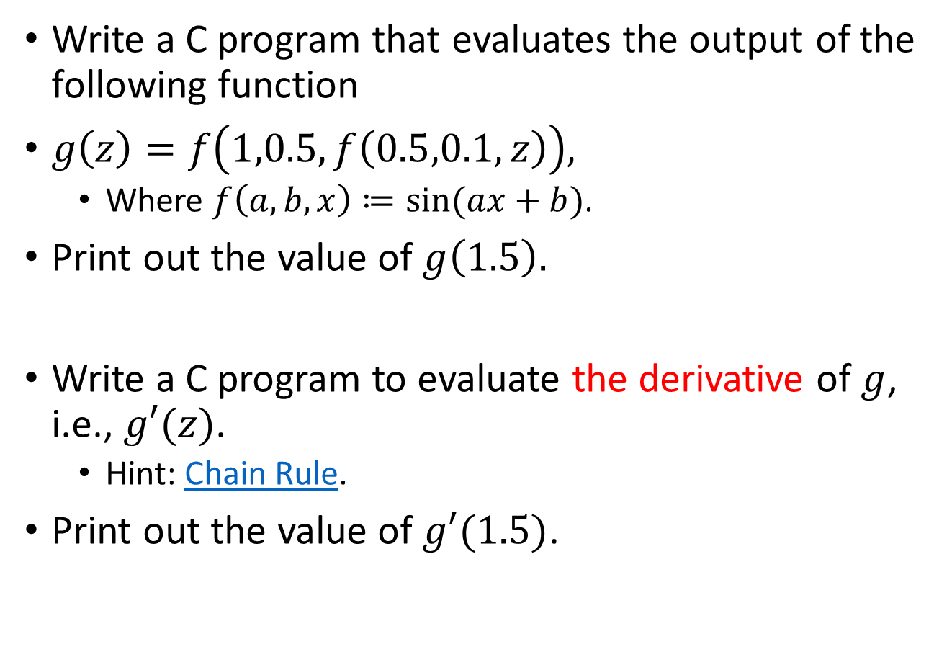
Homework 4 (submit this)
Write a C program that evaluates the output of the following function
$g\left(z\right)=f\left(1,0.5,f\left(0.5,0.1,z\right)\right),$
Where $f\left(a,b,x\right)≔sin⁡(ax+b)$.
Print out the value of $g\left(1.5\right).$
Write a C program to evaluate the derivative of $g$, i.e., $g′(z)$.
Hint: Chain Rule.
Print out the value of$g′(1.5)$.

